Slide 1
Marty Brunke
Transformation at the S.P.E.E.D of DevOps

Slide 2
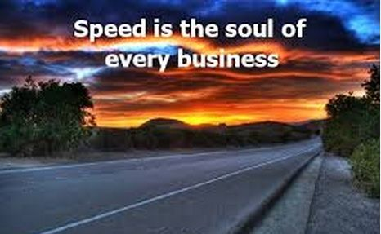
Presentation Agenda
Transformation at the S.P.E.E.D of DevOps
Intro
Little About Me…
My Jerry Maguire Moment
S.P.E.E.D Methodology
Strategy
People Engaged
Executed Deliverable
Closing

Slide 3

Little about me:
MARTIN BRUNKE
Martin provides executive leadership guiding organizations through transformations, culture change and driving continuous delivery, integration and re-engineering of enterprise technology. Martin's passion for people and technology is felt in his presence everyday and evangelist message of people first, processes evolve and technology supports and drives. Martin's 25 year career in Leadership has spanned various industries including Consulting for Fortune 10 companies, Financial Services, Gaming & Hospitality and College Football. Over the past several years Martin has spoken at conferences and industry groups on executing his S.P.E.E.D methodology.
Enjoy spending family time with my Wife Susan, two sons Duke (SR. @ Texas Tech) & Brooks (SO. @ Dixie State) and our 3 furry dogs named Buddha, Louie and Bennett.
Contact Information:
Email: marty.Brunke@leadingagile.com
LinkedIn: https://www.linkedin.com/in/martin-brunke/

Slide 4
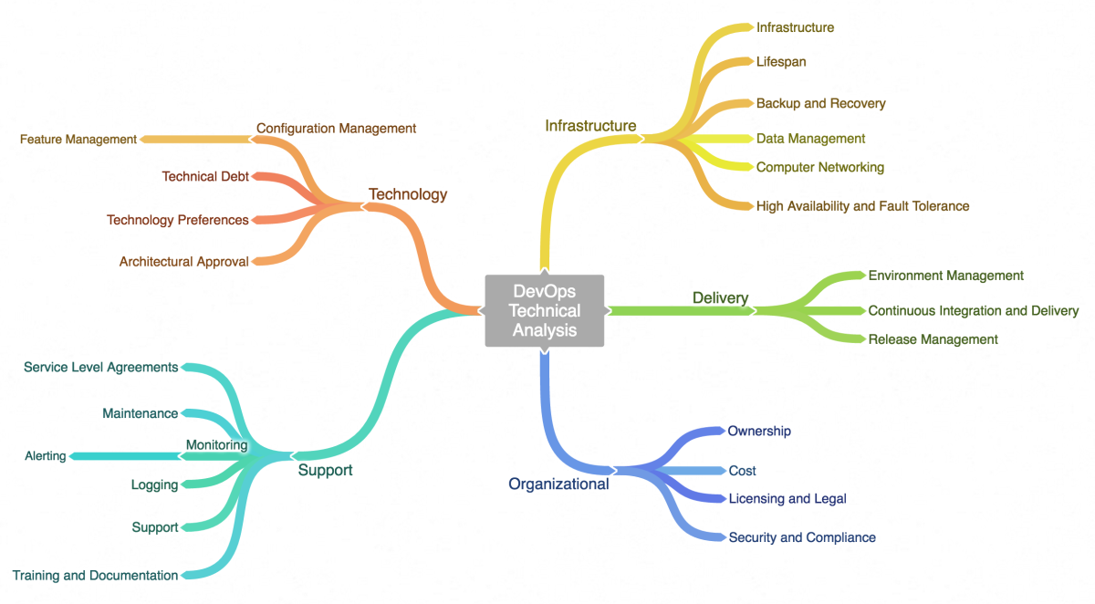
DevOps is more than what you see here
This was my Jerry Maguire moment.
Remembering that it is still people that make success happen. Moreover, it is the people that make organizations succeed.
This is true no matter the technology solutions presented.

Slide 5

My Jerry Maguire Moment
Why are so many organizations falling short of a successful DevOps transformation?
Each organization’s transformation will differ.
Do not let technology be the primary or only reason to transform.
Lead people!
Engage people!
Together, success is possible!
Notes:
Beginning: I had to ask myself in this great migration where everyone is chasing the buzzword “DevOps”
Bullet 1
1) Is it because they are missing necessary technical skill-sets to execute and achieve their objectives 2) Are the processes in place not scalable enough to support what needs to be accomplished? 3) Are you chasing after the never-ending new technology and finding your teams paralyzed.
Bullet 2
1) Therefore, each success and demise will differ as well.
Bullet 3
1) Conforming people to technology limits capabilities.
2) Technology conforming to people and processes, however, results in sustainable value and growth efficiencies.
End: I will share my leadership values I use to successfully transform both mature and immature organizations on the DevOps journey.

Slide 6
S. P. E. E. D Methodology
People Engaged
Strategy
Value
Executed Deliverable
Purpose
When you are at a point of transformation with your company…
Recognize that it is not something to fear,
It is something to celebrate.
Notes:
Today I get to share with you thanks to ADDO, I will not only offer up a challenge but come to you with insight too.

Slide 7
This is going to change everything
Stage 1: Predictability
Stable Teams
Backlogs exist
Delivery Frequently
Measurable Progress
Transparency
HEROIC
EMERGENCE
LEAN
STARTUP
Strategy
Low Trust
Fully Decoupled
Purpose of transformation is in agreement
Organization has capacity
Priorities are aligned
Scalability
Crystal
Stage 2: Improve Flow
Quarterly Agile Planning
Small Batches
Improved Coordination
Introduce Flow Based Metrics
TEAMS
5
LeSS
PE
AE
4
Stage 3: Decoupling
Continuous Integration
Legacy Refactoring
Release Cadence
DevOps
PREDICTABILITY
ADAPTABILITY
PC
AC
Nexus
FDD
DAD
DSDM
3
2
DevOps
Stage 4: Autonomous
Adaptive Governance
Funding Capabilities
Economic Prioritization
Continuous Delivery Capable
Release Cadence
1
SAFe
XP
Scrum
Waterfall
RUP
Stage 5: Invest to Learn
Outcome Based Accountability
Innovation Focused
Design Thinking & Lean Start-Up
Continuous Delivery
Become Predictable
Reduce Batch Size
LEAN/
AGILE
CONVERGENCE
AGILE
Notes:
Beginning: We begin to establish a purpose to align with value, and as leaders we create space for our team members and clearing conditions
Bullet 1
Leadership has identified a strategy and supports the transformation
Business is aligned and ready for new delivery model and end state
Bullet 2
Plans are in place to form new teams and staff where identified
Collocation where necessary and technology to support efforts
Bullet 3
Framework and space is created by leadership and the conditions are constantly safe for the teams to do their work
Bullet 4 (Scalablilty)
GOVERNANCE
Governance is the way we make economic tradeoffs in the face of constraints
STRUCTURE
They way we form teams and foster collaboration at all levels of the organization
MEASURE AND MANAGE FLOW
What we measure, how we baseline performance, and how we show improvement

Slide 8

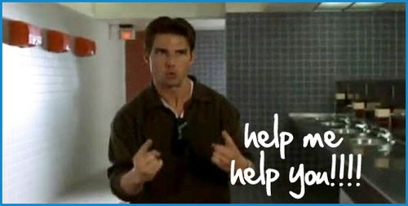
Help Me Help You
People Engaged
Identify and establish roles / skills needed
What does it takes to provide End to End delivery
Purpose / Value understanding
A group of teams moving together from their current state to their future state
Notes:
Beginning:
Bullet 1
Build and Form teams that align and deliver value to the Business / Customer / Product / Service
Product Driven Organization approach
Bullet 2
Capture all the work needed to deliver from beginning to end (all the touchpoints)
Algorithmic vs Heuristic (Automation and Collaborative type of work)
Encapsulate vs Orchestrate (80/20 rule and identify dependencies)

Slide 9




Executed Deliverable
Show Me The Value
Outcome aligns with Business/Product/Service
Value can be realized
Metrics can be used to validate
BACKLOGS
TEAMS
WORKING TESTED product
Small enough for the team to develop in a day or so
Independent, Negotiable, Valuable, Estimable, Sized appropriately, Testable
Everything and everyone necessary to deliver
Meets acceptance criteria
No known defects
No unplanned technical debt
Notes:
Improved Engagement
Faster time to Value
Higher quality

Slide 10





Show Me The Value
Feet on the Ground
Eyes on the Horizon
Lead time
Cycle time
Reduce Time to Market by 40%
Increase Output by 125%
Availability
Change Success/Failure Rate
Mean Time to Resolution
Improve Quality by 50%
Reduce Labor Cost by 20%
Improve Run Mix by 15%
Team / Product / Business Capability level NPS
Outcome based maturity score
Improve Engagement by X%
Improve Team NPS by X%

Slide 11
I Challenge You…
As a transformational leader, armed with this information…
Would you adjust your strategy accordingly?

